Slide 1
Human Visual System

Slide 2
Understanding HVS, Why?
Image is to be SEEN!
Perceptual Based Image Processing
Focus on perceptually significant information
Discard perceptually insignificant information
Issues:
Biological
Psychophysical

Slide 3
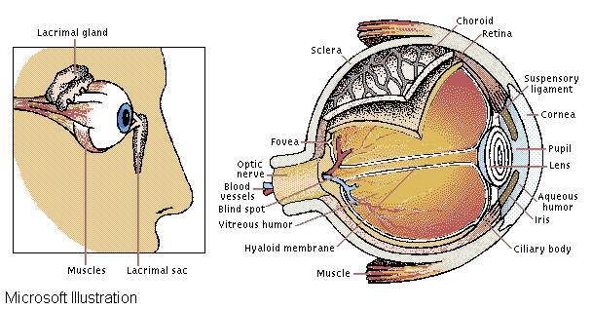
Illustration of Human Eye
The amount of light entering the eye is controlled by the pupil, which dilates and contracts accordingly. The cornea and lens, whose shape is adjusted by the ciliary body, focus the light on the retina, where receptors convert it into nerve signals that pass to the brain. A mesh of blood vessels, the choroid, supplies the retina with oxygen and sugar.

Slide 4
Structures of Human eyes
A shape like a sphere. Average diameter = 20 mm
Membranes:
Cornea and Sclera
Choroid
Retina

Slide 5
Structures of Human eyes
Cornea : tough, transparent tissue, covers the anterior surface of the eye.
Sclera : Opaque membrane, encloses the remainder of the optic globe
Choroid : Lies below the sclera, contains network of blood vessels that serve as the major source of nutrition to the eye.
Lens: absorb both infrared and ultraviolet by proteins within the lens structure and, in excessive amounts, can cause damage to the eye
Retina: Inner most membrane of the eye which lines inside of the wall’s entire posterior portion. When the eye is properly focused, light from an object outside the eye is imaged on the retina

Slide 6
Receptors
Receptors (neurons) is distributed over the surface of the retina.
Receptors are divided into 2 classes:
Cones
Rods
Cones (neurons 6-7 million)
located primarily in the central portion of the retina (the fovea, muscles controlling the eye rotate the eyeball until the image falls on the fovea).
Highly sensitive to color.
Each is connected to its own nerve end thus human can resolve fine details.
Cone vision is called photopic or bright-light vision.

Slide 7
Receptors
Rods (75-150 million),
distributed over the retina surface.
Several rods are connected to a single nerve end reduce the amount of detail discernible.
Serve to give a general, overall picture of the field of view.
Sensitive to low levels of illumination.
Rod vision is called scotopic or dim-light vision.

Slide 8
Distribution of receptors
Light passes through cornea, iris, lens and form image on retina.
Two types of photoreceptors on retina:
Cones cluster at Fovea, detect color at bright light - photopic vision
Rods spread at back of eye, general vision - scotopic vision
Receptor density is measured in degrees from the fovea.
Cones are most dense in the center of the retina (in the area of the fovea).
Rods increase in density from the center out to approx. 20° off axis and then decrease in density out to the extreme periphery of the retina
Blind spot : the absence of receptors area.

Slide 9
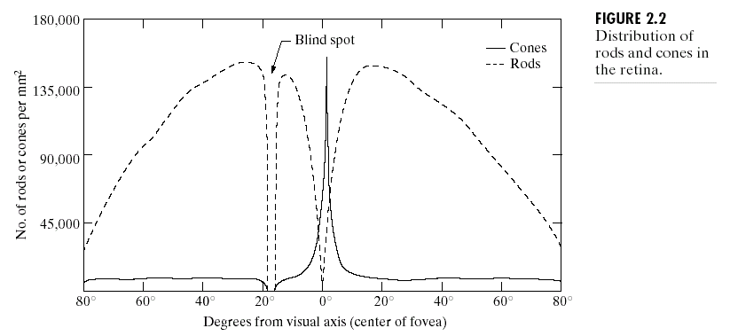
Distribution of receptors

Slide 10
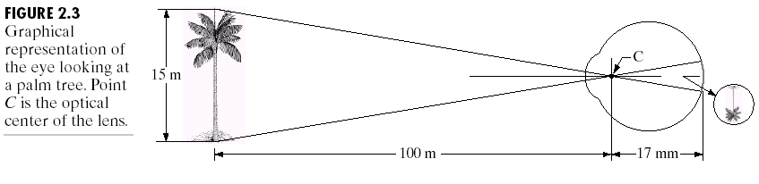
Image formation
Distance between center of lens and retina (focal length) vary between 14-17 mm.
When object is 3 m or more away, f = 17mm with lowest refractive power.
Image length h = 17(mm) x (15/100)

Slide 11
Visual Psychophysics
Model vision "system" as an input-output system
visual stimuli: input
prescribed sensations: output.
Visual psychophysics:
Characterize the response of HVS to different stimuli

Slide 12
Visual Psychophysics
Brightness Adaptation
Spatial Threshold Vision
Weber ratio
Visual Masking
Mach Effect
Temporal vision
Frequency Threshold Vision

Slide 13
Brightness Adaptation
HVS can view large intensity range (10¹⁰)
But simultaneous perceived intensity range is much smaller.
If one is at B_{a} intensity (outside) and walk into a dark theater, he can only distinguish up to B_{b}. It will take much longer for eye to adapt for the scotopic vision to pick up.

Slide 14
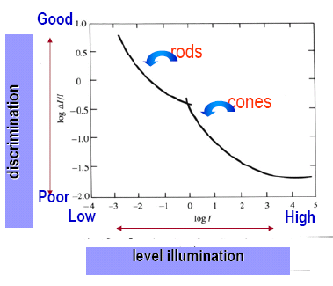
Weber ratio
Brightness discrimination is poor (the Weber ratio is large) at low levels of illumination and improves significantly (the ratio decreases) as background illumination increases
Hard to distinguish the discrimination when it is bright area but easier when the discrimination is on a dark area.

Slide 15
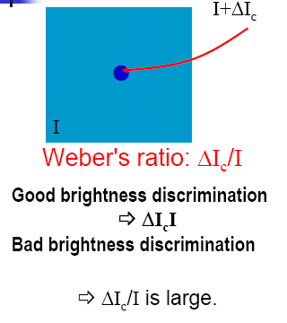
Contrast sensitivity
The ability of the eye to discrimination b/w changes in brightness at any specific adaptation level is of considerable interest.
I is uniformly illumination on a flat area large enough to occupy the entire field of view.
ΔIc is the change in the object brightness required to just distinguish the object from the background

Slide 16
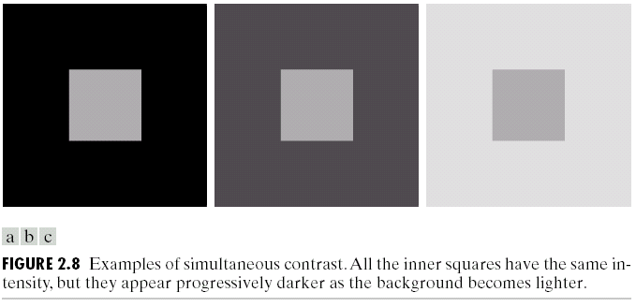
Simultaneous contrast
Which small square is the darkest one ?
Brightness perceived does not depend simply on its intensity.

Slide 17
Simultaneous Contrast
The perceived brightness of inner circle are different due to different background intensity levels even they are identical.

Slide 18
Brightness vs.Function of intensity
Brightness is not a simple function of intensity.
visual system tends to undershoot or overshoot around the boundary of regions of different intensities. the intensity of the stripes is constant but we actually perceive a brightness pattern is strongly scalloped near the boundaries.

Slide 19
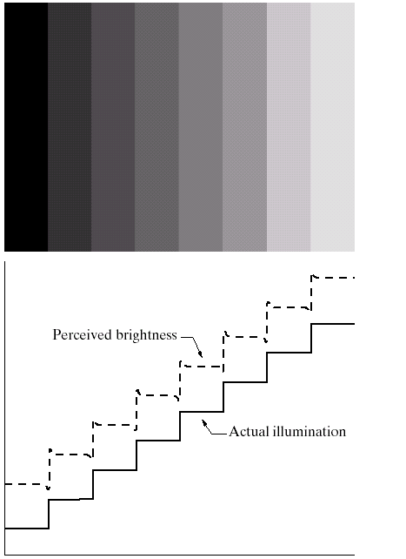
Mach Band Effect
Perceived Brightness changes around strong edges.

Slide 20
Temporal Vision
Perceived spatial resolution reduced sharply at scene change
Flicker fusion: the basis of movie and TV
Eye is more sensitive to flicker at high luminance than low luminance.

Slide 21
Frequency Threshold Vision
Using spatial grating, it is found that contrast sensitivity is a function of spatial and temporal frequencies.
In general, the contrast sensitivity decreases as spatial and temporal frequencies increases.

Slide 22
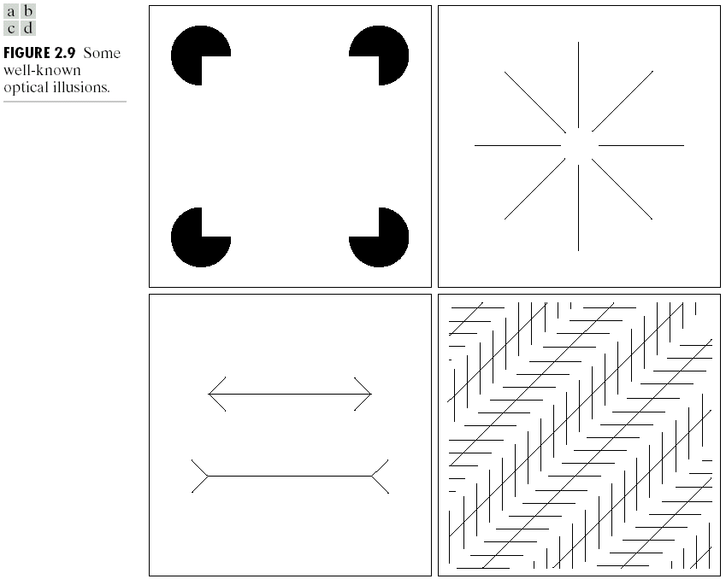
Optical Illusions

Slide 23
Basics of image acquisition
Human eye sense visible light
Visible light is just a part of EM spectrum
Based on the human vision, people build up ‘camera’ image sensing system for different EM waves.
Sense → ‘Camera’ → Digitizer → Computer → DIP→ Display
Sense comes to the camera by mean of EM signals. A signal carries an energy that can be sensed by the sensor in camera

Slide 24
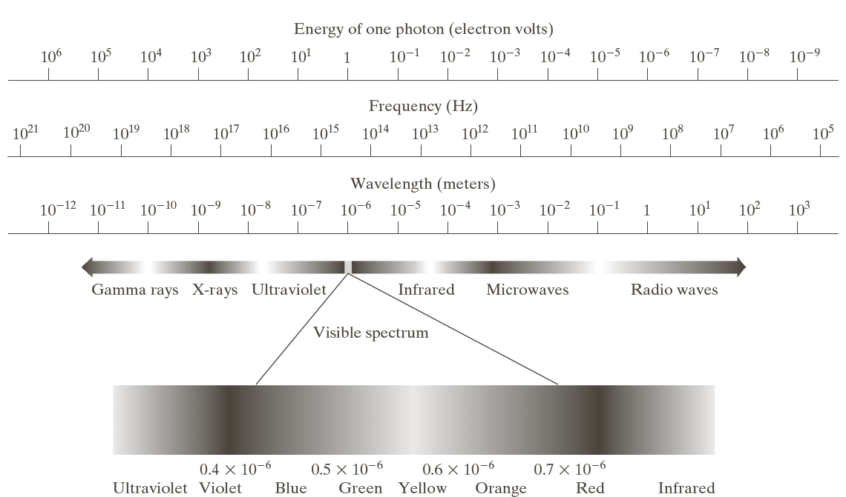
Electromagnetic Spectrum
Wavelength λ
Frequency f
speed of light c = 2.998*10^8 m/s
Relation λ f = c
Energy of EM component: E = p λ (p is Planck’s contant) Planck's constant = 6.626068 × 10⁻³⁴ m² kg / s

Slide 25
Image Capture Device “Camera”
Physical device sensitive to band in EM energy spectrum (e.g. x-ray, ultraviolet, visible, infrared)
Produces an electronic signal output proportional to the level of energy sensed
Need:
Sensor/transducer to measure the ‘intensity’
Sampling aperture to access each picture element individually mechanism for scanning the image to move the sampling aperture over the image
Criteria:
Size of the sampling aparture
Spacing between adjacent pixels
Image size capability on input and output
Physical parameter measured and quantized
Noise level

Slide 26
Image Sensing and Acquisition
A ‘Camera’ usually has lens that collects the appropriate type of radiation emitted from the object of interest and that forms an image of the real object
A semiconductor device – so called charged coupled device or CCD which converts the irradiance at the image plan into an electrical signal.
Frame grabber only needs circuits to digitize the electrical signal from the imaging sensor to store the image in the memory (RAM) of the computer.

Slide 27
Digitizer
Convert electronically output of image capture device into digital form
Sampler: sample on discrete grid, spatial resolution
Quantizer: sample /pixel is quantitied using finite number of bits
Storage:
Acquisition storage
Processing storage
Archival storage
Frame buffer – memory to store digital image
Frame grabber: digitizer working at video rate with onboard frame buffer

Slide 28
Signals
A signal is a function that carries information. usually content of the signal changes over some set of spatiotemporal dimensions.
Signal can vary over time: f(t)
Signals can vary over space
An image can be thought of as being a function of 2 spatial dimensions: f(x, y) for monochromatic images, the value of the function is the amount of light at that point.
Medical CAT and MRI scanners produce images that are functions of 3 spatial dimensions: f(x,y,z)
Spatiotemporal signals: f(x,y, t), x and y are spatial dimensions; t is time.

Slide 29
Types of Signals
Continuous vs Discrete Domain
Most naturally-occurring signals are functions having a continuous domain
Signals in a computer have are discrete samples of the continuous domain.
Analog and Digital
Most naturally-occurring signals also have a real-valued range in which values occur with infinite precision.
To store and manipulate signals by computer we need to store these numbers with finite precision. Hence have to be digital.
signal has continuous domain and range = analog
signal has discrete domain and range = digital

Slide 30
Convert between Analog and Digital
Analog to digital convert (ADC)
Sampling => Quantization => Digitalization
Sampling is usually done by scanning
Quantization is done by dividing the range to many level, and then check which level the scanned value falls
Digitalization: represent the value of each level by a number (binary)

Slide 31
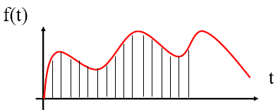
Sampling
sampling = the spacing of discrete values in the domain of a signal.
sampling-rate = how many samples are taken per unit of each dimension. e.g., samples per second, frames per second,

Slide 32
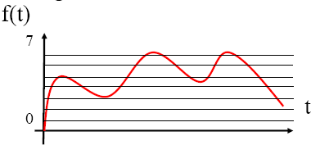
Quantization
Quantization = spacing of discrete values in the range of a signal, usually thought of as the number of bits per sample of the signal. e.g., 1 bit per pixel (b/w images), 16-bit audio, 24-bit color images, etc. 8 levels = 2^3 : uses 3 bits

Slide 33
Scanning convention for 2D image
Scanning conventions output by camera and used by digitizer to determine signal position.
Progressive scanning using horizontal synchronize pulse
Frame = complete scan of target
Scan rate : how many frames / second

Slide 34
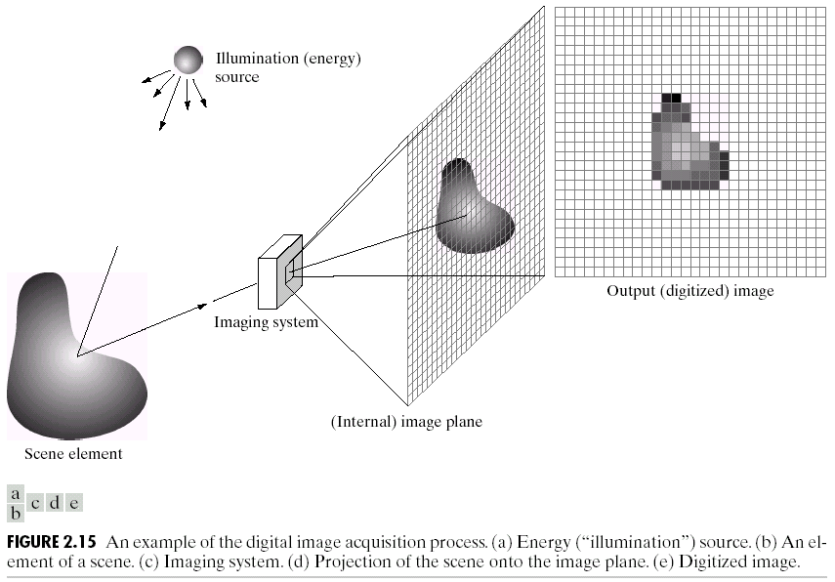

Slide 38
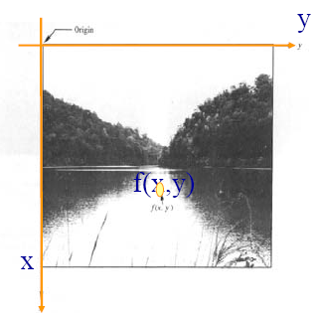
Digital Image Representation
A digital image is an image f(x,y) that has been digitized both in spatial coordinates and brightness.
The value of f at any point (x,y) is proportional to the brightness (or gray level) of the image at that point.

Slide 39
Digital Image Representation
A digital image can be considered a matrix whose row and column indices identify a point in the image and the corresponding matrix element value identifies the gray level at that point.

Slide 40
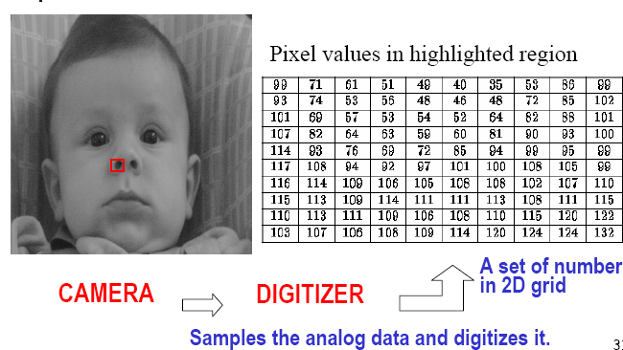
Example of Digital Image
Digital Image Representation

Slide 41
Gray level
The intensity of a monochrome image f at coordinate l(x,y) the gray level of the image at that point.
gray scale = [Lmin, Lmax], common practice, shift the interval to [0, L], 0 = black , L = white

Slide 42
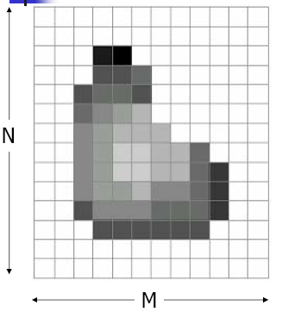
Number of bits is k, the number of gray levels L = 2^k
Number of bits required to store a digitized image of M x N pixels (resolution)
The size of an image
b = M x N x k

Slide 43
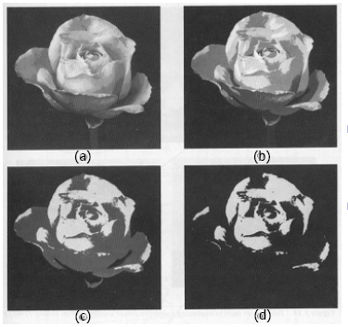
False contouring effect
If the gray scale is not enough, the smooth area will be affected. False contouring can occur on the smooth area which has fine gray scales.
(a) Gray level = 16
(b) Gray level = 8
(c) Gray level = 4
(d) Gray level = 2

Slide 44
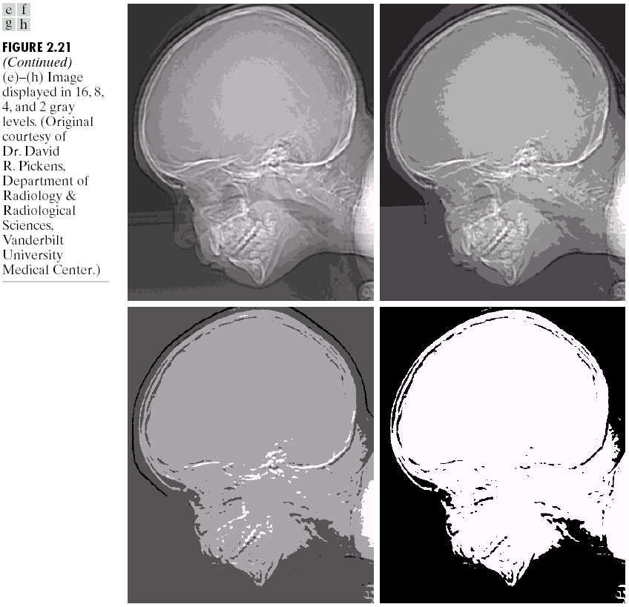

Slide 45
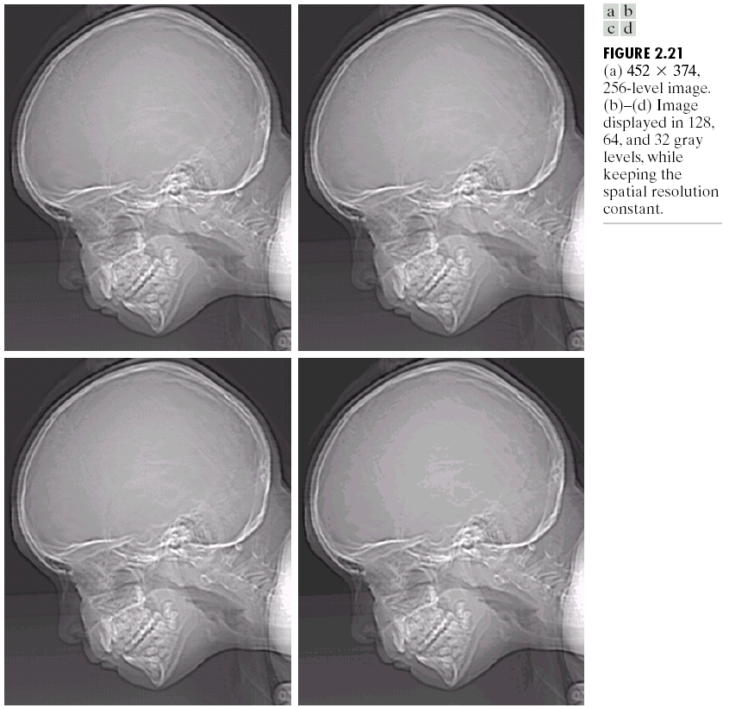

Slide 46
Resolution
Resolution (how much you can see the detail of the image) depends on sampling and gray levels.
The bigger the sampling rate (n) and the gray scale (g), the better the approximation of the digitized image from the original.
The more the quantization scale becomes, the bigger the size of the digitized image.

Slide 47
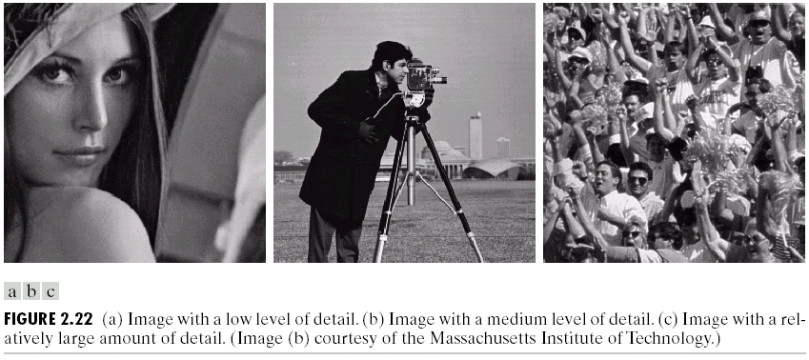
Non uniform sampling
For a fixed value of spatial resolution, the appearance of the image can be improved by using adaptive sampling rates.
Fine sampling required in the neighborhood of sharp gray-level transitions.
Coarse sampling utilized in relatively smooth regions.

Slide 48
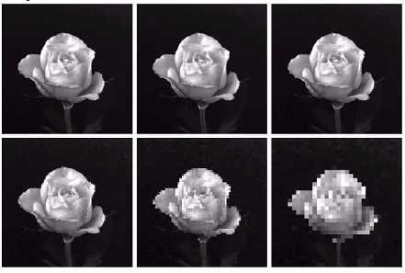
Checkerboard effect
If the resolution is decreased too much, the checkerboard
effect can occur.

